Slide 1
Capstone Project The Prediction of severe accidents with Collision Data (Case Study: Seattle)
Natascha Hey
09/16/2020

Slide 2
Introduction: Business Problem
Objective:
To examine the probability getting into a car accident and to predict the severity of this accident.
Who can profit ?
Car insurance providers
Car manufacturers
Car drivers and with them pedestrians and cyclists
How can machine learning help?
→ Machine learning helps to assess the highest risk factors of a severe accident
Since we have a binary problem (Is the accident severe or not?) we can use KNN, SVM, logistic regression or a Decision Tree algorithm to predict the outcome. (see Methodology)

Slide 3
DATA
The following dataset provides all collisions published by the Seattle Police Department from 2004 to present:
Dataset:
https://s3.us.cloud-object-storage.appdomain.cloud/cf-courses-data/CognitiveClass/DP0701EN/version-2/Metadata.pdf
Description to data:
https://s3.us.cloud-object-storage.appdomain.cloud/cf-courses-data/CognitiveClass/DP0701EN/version-2/Data-Collisions.csv

Slide 4
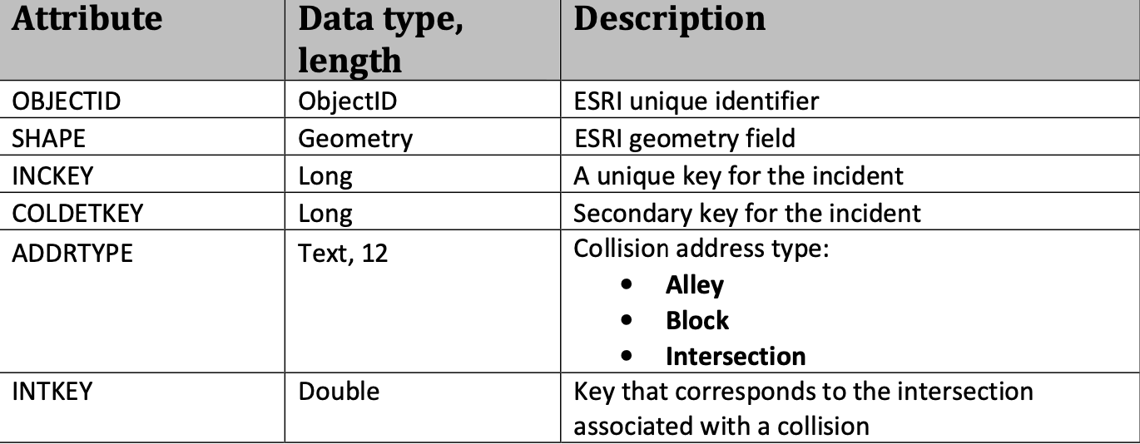
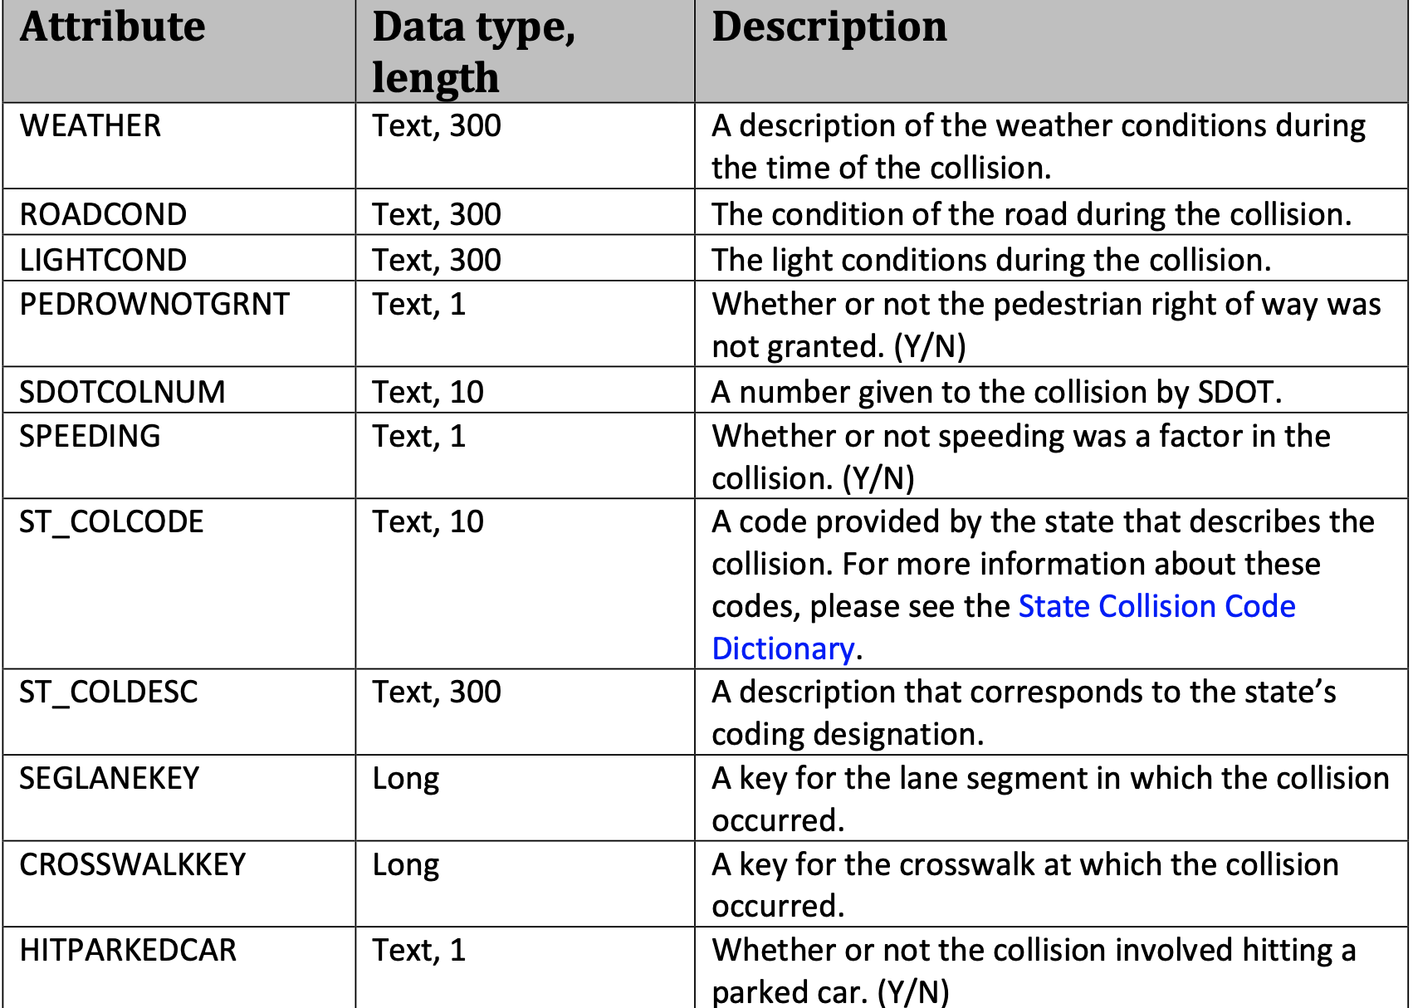
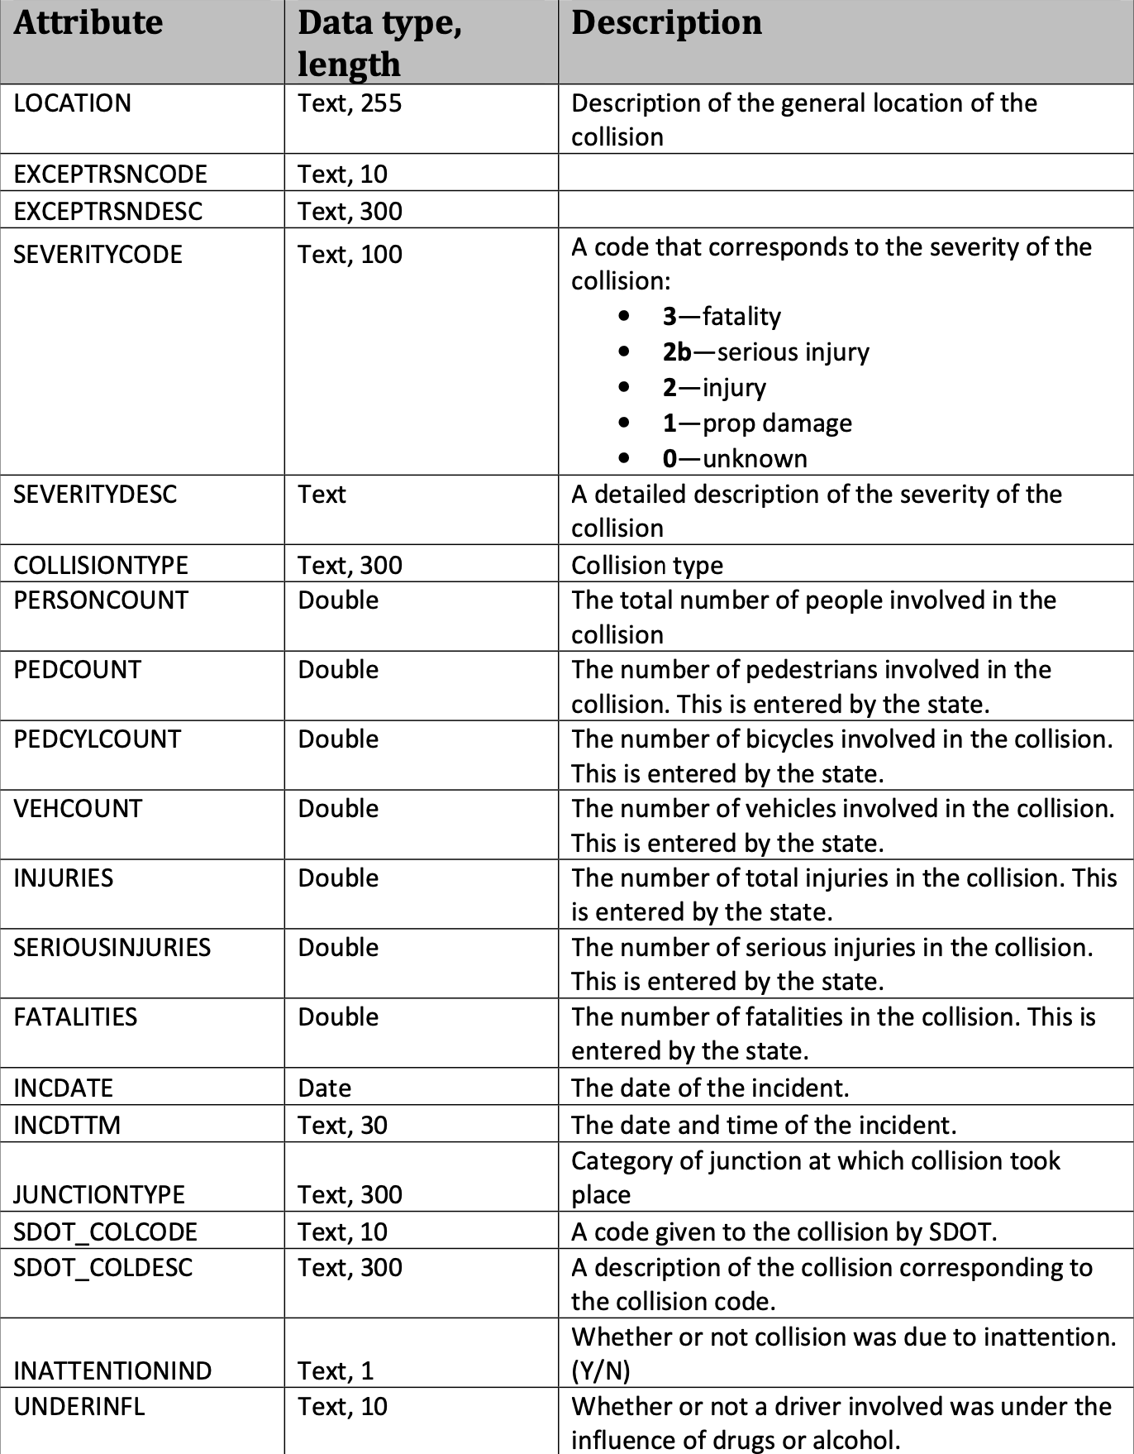
Data

Slide 5
Data
Choice of Data by groups:
Target column: ‘SEVERITYCODE’
Locations or hazardous areas 'X', 'Y' 'ADDRTYPE' 'LOCATION' JUNCTIONTYPE'
Conditions caused by Nature WEATHER', 'ROADCOND', 'LIGHTCOND',
Human Failure 'INATTENTIONIND', 'UNDERINFL’, ‘SPEEDING’
Count accident participants 'PERSONCOUNT', 'PEDCOUNT', 'PEDCYLCOUNT', 'VEHCOUNT',
Time of the Accident 'INCDTTM',
Unnecessary columns (the rest to be dropped)
Dataset is not balanced
1 136485 (not severe accidents)
2 58188 (severe accidents)

Slide 6
Methodology
Data preparation
extract the data from a csv file and store it into a data frames using pandas and numpy
Clean data and drop all nan or convert to 0
Check datatype in each column. For instance, in column 'UNDERINFL', we find the unique data entries ‘N’,’Y’,’0’,’1’. For the data to be accurately evaluated, the strings had to be mapped by {‘Y’:0,’N’:1}
Create dummies for categorial data
Data Visualization
Bar graphs with matplotlib.pyplot,
KNN clusters with mlxtend.plotting
Traffic data visualization on Seattle map with folium
Confusion Matrix with sklearn.metrics
Modeling
Classification with KNN, SVM, Logistic Regression with sklearn
F1 and Jaccard Index for accuracy

Slide 7
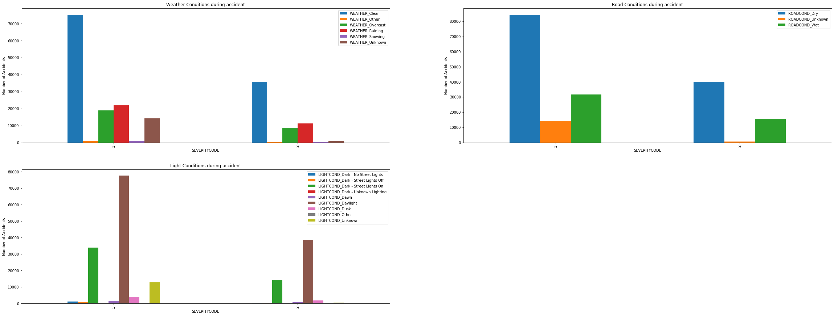
DATA Analysis 1) Accidents caused by bad weather conditions
Severe Accidents more likely when:
Weather =
‘Rainy’, ‘Overcast’
Light Conditions =
‘Dark’
Road Conditions=
‘Wet’

Slide 8
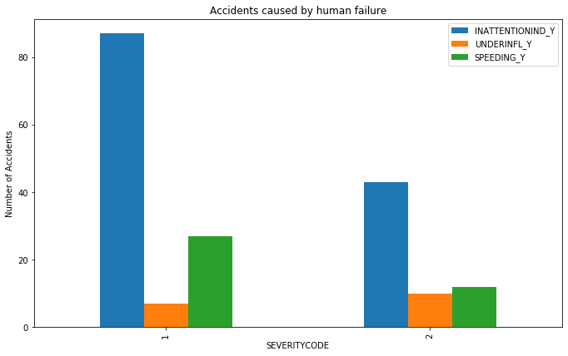
2) Accidents caused by human failure
Severe accidents are more likely to happen when Speeding and under influence.

Slide 9
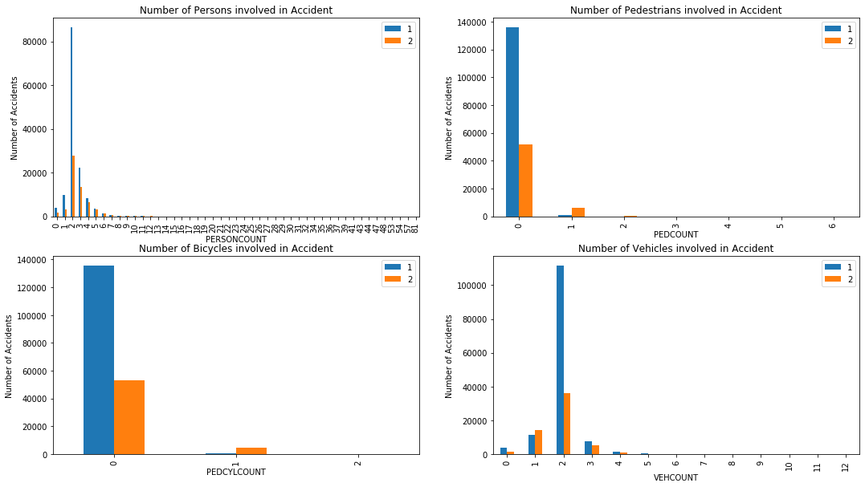
3) Count of Participants in Accident
Personcount:
The more persons involved, the more likely it is for the accident to be severe
Pedcylcount and Pedcount:
If pedestrians and bicycle riders are involved, the accident is likely to be severe.
Vehcount:
The accident is likely to be severe when more vehicles are involved

Slide 10
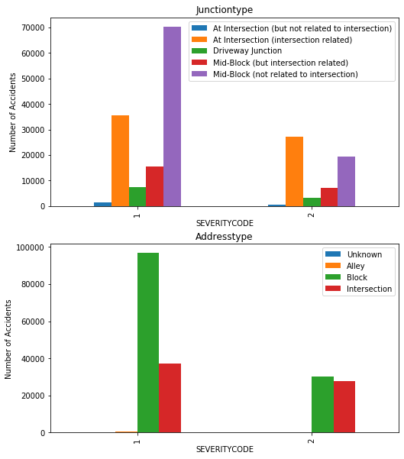
4) Address and Junction Types
Severe accidents are more likely to happen at Intersections

Slide 11
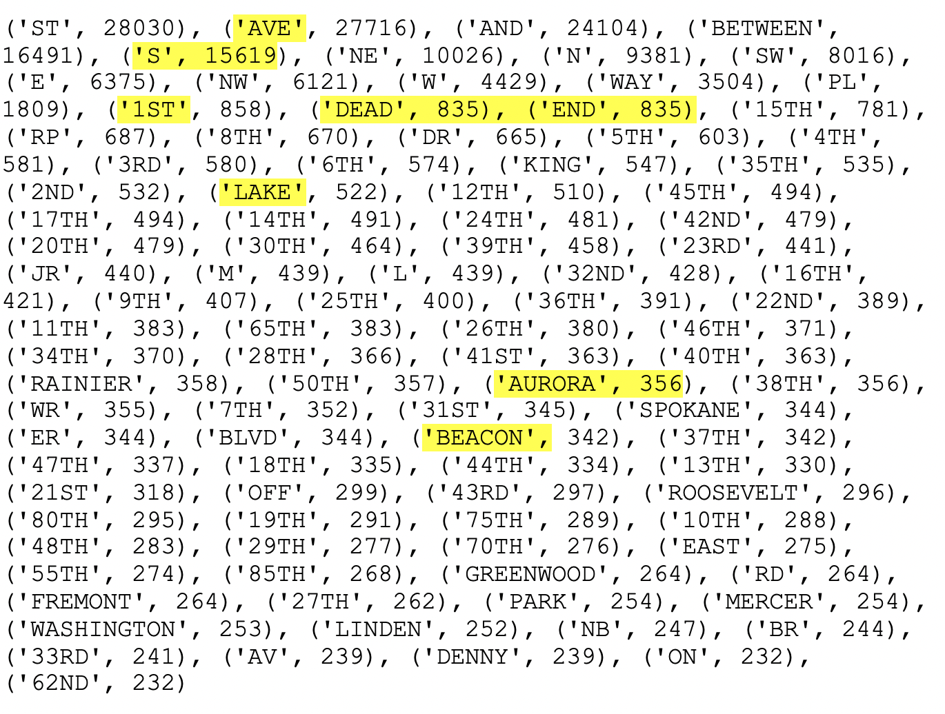
5) Locations
5.1) String Analysis
Many accidents occur
In ‘Dead Ends’
Along 1st, Beacon and Aurora Avenue
More in the South

Slide 12
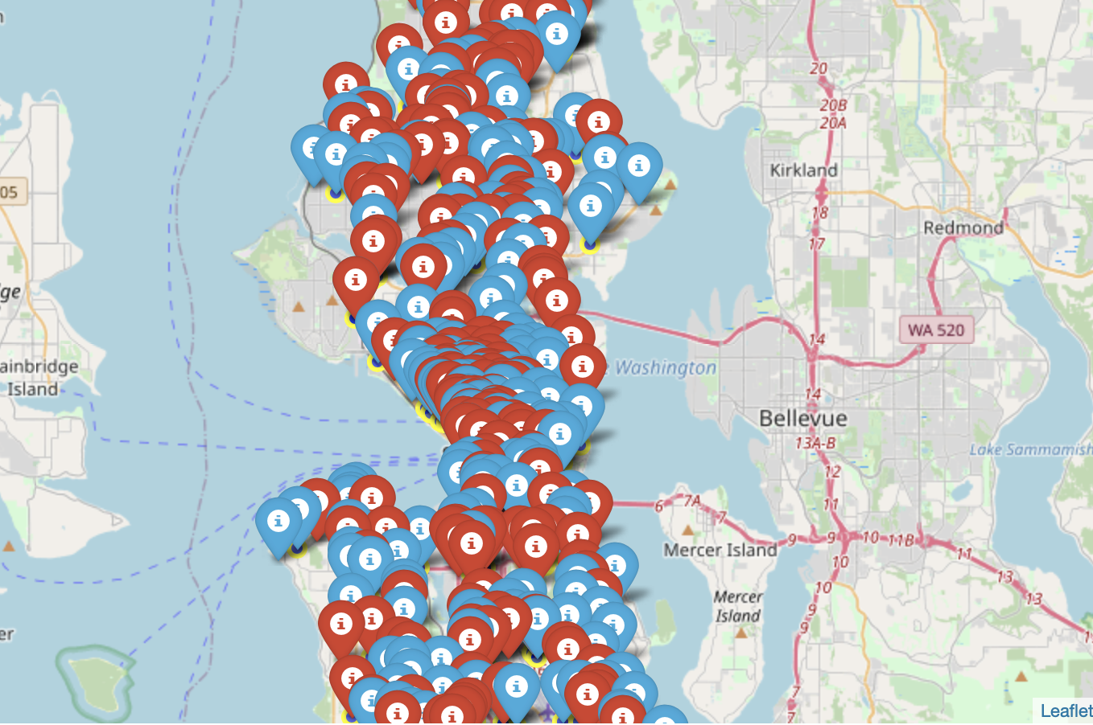
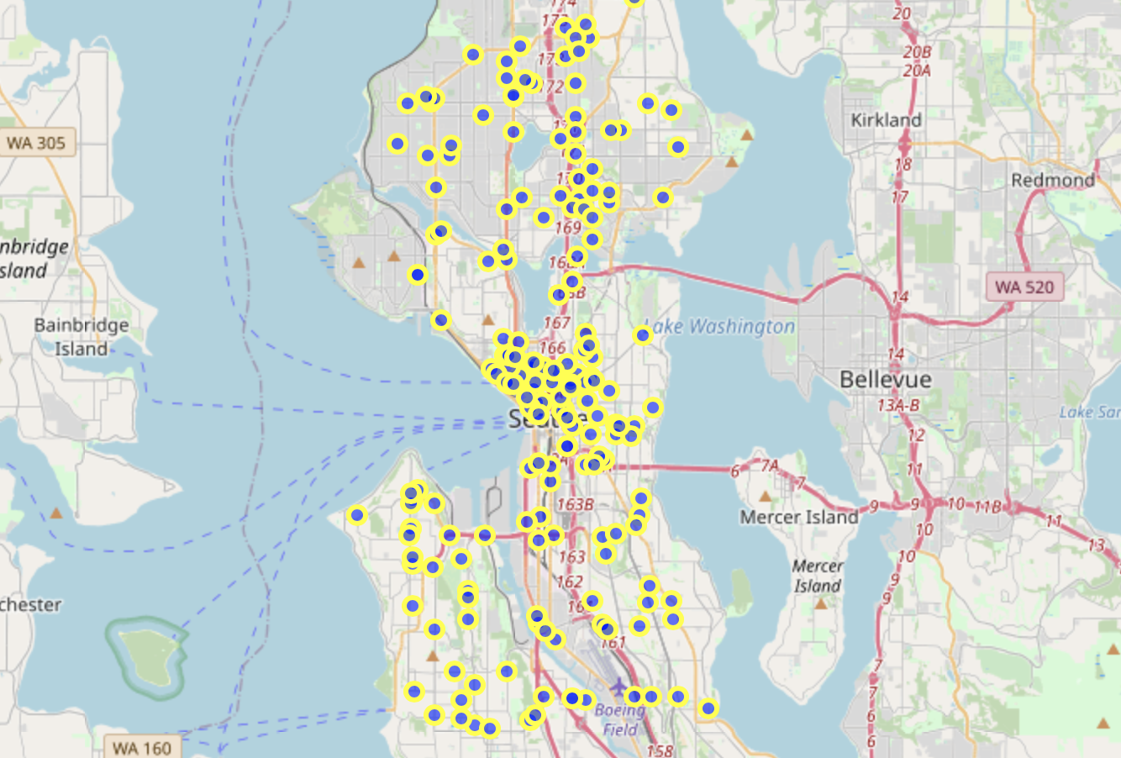
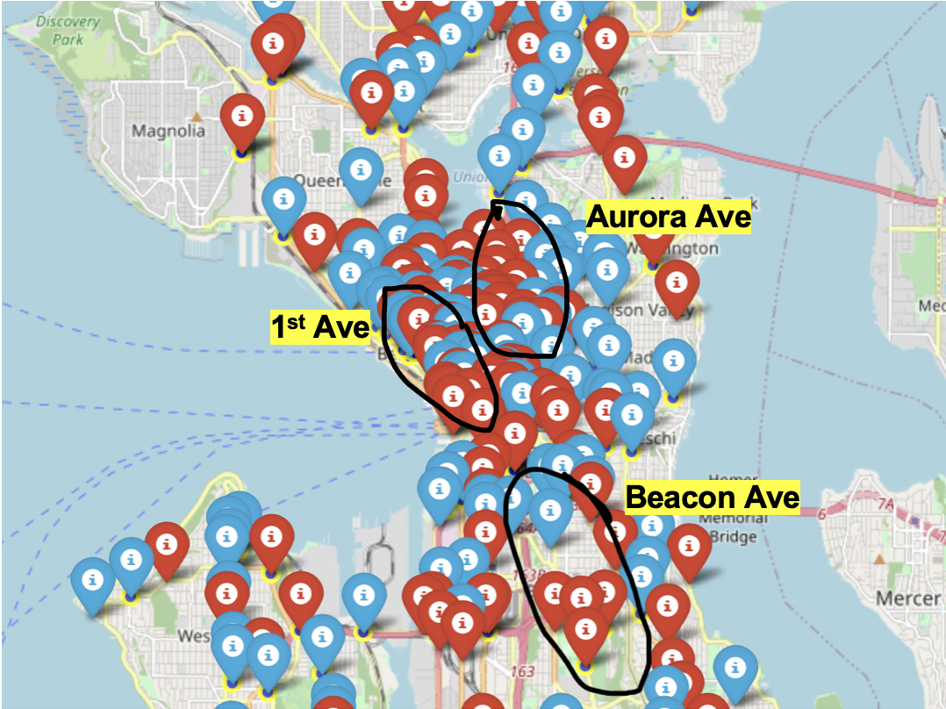
5) Locations
5.2) Spatial Data Analysis with Folium

Slide 13
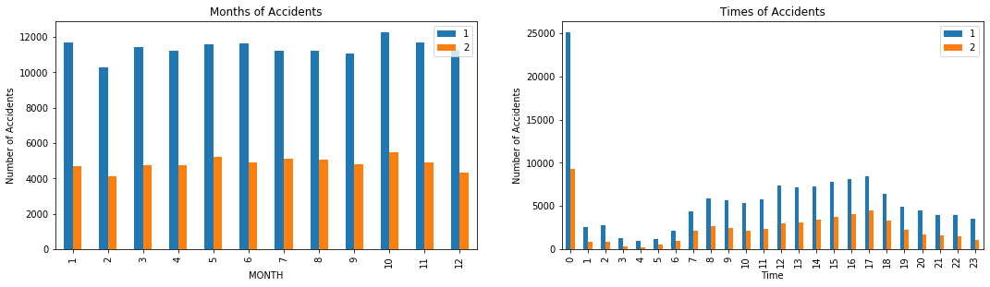
6) Time of accident
Months:
(Severe) accidents are more likely to happen in October
Time:
Severe accidents are more likely to happen during rush-hour and at midnight

Slide 14
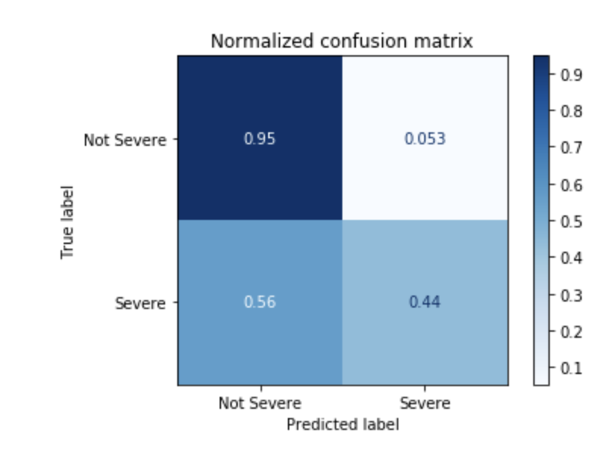
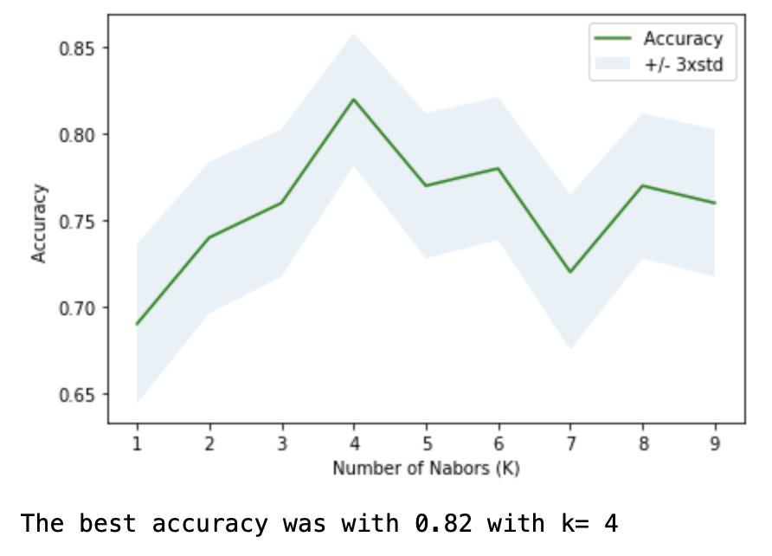
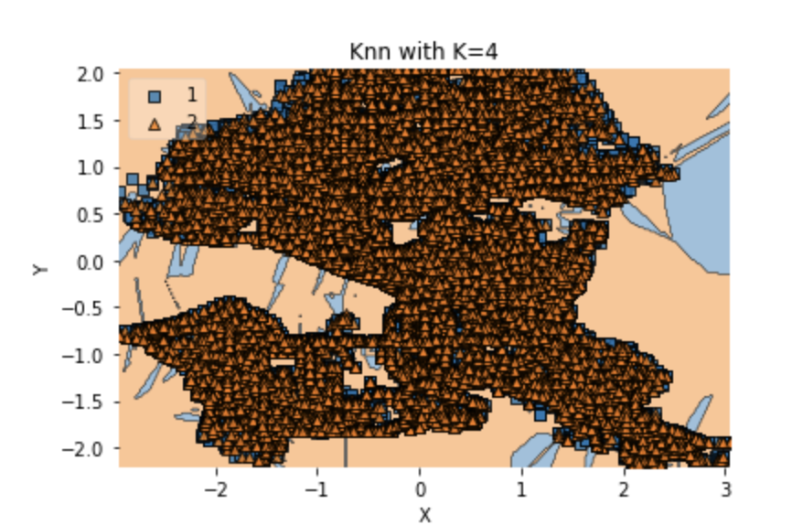
Results
The KNN algorithm delivers the best result for k = 4 with a F1 score of 0.803 and a Jaccard index of 0.82.

Slide 15
Discussion
It is very good in predicting not severe accidents. However, it labels many data as “not severe” even though the accident was severe. Several problems in the data causes this inaccuracy:
Many attributes which could strongly indicate the risk of a severe accident like ‘SPEEDING’ or ‘INATTENTION’ are labeled as unknown. In such cases the police could neither verify nor falsify if the driver broke the law.
Therefore, to get a more accurate result, the speed of the car before the accident had happened and the allowed speed limit should be included into the dataset. Furthermore, street types such as highways or roads should be another categorical variable in the dataset.
The dataset was in general unbalanced with a ratio 13:5 of not severe accidents to severe accidents.
Nevertheless, for the given dataset the algorithm performs well given the dataset.

Slide 16
CONclusion
As suggested, the most important features which contribute to the probability of severe accidents are hazardous areas like junctions, weather conditions, human failure, number of accident participants and the time of the accident. Additionally, the location given by geographical coordinates can also contribute to determine whether or not a severe accident is likely to happen. Therefore, to provide the best estimation of danger for a driver, it is important to analyze…
… his upcoming route with the most dangerous zones given by a KNN clustering.
… if the driver is not under influence and is reminded not to speed.
… the weather, lighting and road conditions.
… the time of the day and the year. For if it is late and autumn or winter, severe accidents are more likely to happen.
Opportunity:
To warn a driver before starting his ride, applications can be developed for cities to take those collision statistics into account. Those warning systems could even be integrated in GPS devices.

